Slide 1
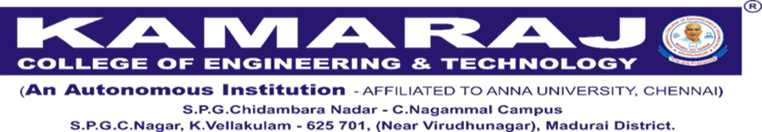
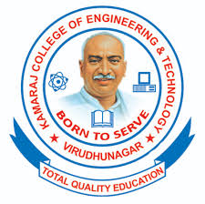

DEPARTMENT OF CHEMISTRY
Presented by
  Mr. A.R. SIVAKUMAR, AP/CHEMISTRY
  KAMARAJ COLLEGE OF ENGINEERING AND TECHNOLOGY (AUTONOMOUS)
  VIRUDHUNAGAR
SUB.CODE:CY1171
SUB .NAME:ENGINEERING CHEMISTRY
UNIT-I WATER TECHNOLOGY

Slide 2

SYLLABUS…….
TOTAL UNITS – 5 : TOTAL HOURS-45
OBJECTIVES…
To enable the students to understand
Water quality parameters and water treatment techniques.
Principles and applications of electrochemistry, its processes and storage devices.
The various energy sources and their applications
The basic concepts of polymers, their properties and some of the important applications.
The basic principles and preparatory methods of engineering materials and nanomaterials.

Slide 3
SYLLABUS..
UNIT HEADINGS….
UNIT I WATER AND ITS TREATMENT
UNIT II ELECTROCHEMISTRY
UNIT III ENERGY SOURCES
UNIT IV POLYMERS
UNIT V ENGINEERING MATERIALS

Slide 4
UNIT-1: WATER AND ITS TREATMENT 9
Water – sources and impurities – water quality parameters: colour, odour, pH, hardness, alkalinity, TDS, COD and BOD. Boiler feed water – requirement – troubles (scale & sludge, caustic embrittlement, boiler corrosion and priming & foaming). Internal conditioning – phosphate, calgon and carbonate treatment. External conditioning - zeolite (permutit) and ion exchange demineralization. Municipal water treatment process – primary (screening, sedimentation and coagulation), secondary (activated sludge process and trickling filter process) and tertiary (ozonolysis, UV treatment, chlorination, reverse osmosis).

Slide 5
UNIT II ELECTROCHEMISTRY 9
Introduction –Electrochemical cells – Reversible and irreversible cells – Concentration Cells - EMF - Measurement of EMF - Electrode potential – Single Electrode Potential – Nernst Equation (Problems) – Reference electrodes – Calomel electrode – Glass electrode – EMF Series – Significance – Applications of EMF measurements: Potentiometric Titrations. Storage Devices: Batteries and Super capacitors - Types of batteries - alkaline, lead-acid, nickel-cadmium and lithium batteries - construction, working and commercial applications. Fuel Cells – H₂-O₂ fuel cell – Microbial Fuel Cells.

Slide 6
UNIT III ENERGY SOURCES 9
Conventional and Non Conventional Energy Sources – Conventional: Fossil Fuels - classification of fuels - coal - analysis of coal (proximate and ultimate) - carbonization - manufacture of metallurgical coke (Otto Hoffmann method) - petroleum - manufacture of synthetic petrol (Bergius process) - natural gas - compressed natural gas (CNG) - liquefied petroleum gases (LPG). Non Conventional: Solar energy – Solar Energy Conversion – Solar Cells, Wind Energy, Nuclear Energy – Nuclear fission and fusion – Nuclear chain reactions - Nuclear reactor – Nuclear Power Plant – Breeder Reactor.

Slide 7
UNIT IV POLYMERS 9
Introduction: Functionality - degree of polymerization- Classification of polymers- natural and synthetic, thermoplastic and thermosetting. Types and mechanism of polymerization: addition (free radical, cationic, anionic and coordination); condensation and copolymerization. Properties of polymers: Tg, tacticity, molecular weight-weight average, number average and polydispersity index. Techniques of polymerization: Bulk, emulsion, solution and suspension. Synthesis, Properties and uses of: PE, PVC, Nylon 66, Bakelite, Epoxy resins.

Slide 8
UNIT V ENGINEERING MATERIALS 9
Introduction - Portland cement- manufacture and properties - setting and hardening of cement, special cement- waterproof and white cement–properties and uses - Glass - manufacture, types, properties and uses.
Nanomaterials - Basics-distinction between molecules, nanomaterials and bulk materials; size-dependent properties – Synthesis of nanomaterials: sol-gel, solvothermal, laser ablation, chemical vapour deposition, Precipitation & electrochemical deposition – General Applications.

Slide 9
WATER TECHNOLOGY
1

Slide 10
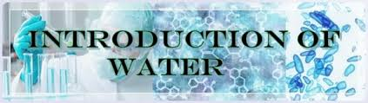

Slide 11
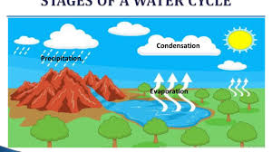

Slide 12
UNIT-I
INTRODUCTION OF WATER…..
Water is one of the essential requirements for life.
All living things need water for their survival.
Water is used for a variety of purposes, including drinking, food preparation, irrigation and manufacturing.
Although water covers more than 70% of the Earth’s surface, less than 1% of that resource is available as fresh water – and this is not evenly distributed throughout the world.
More than one billion people (one thousand million) worldwide, mostly in developing countries, lack safe drinking water.
Apart from the scarcity of water, there are many other challenges in providing a safe, adequate and reliable water supply in many parts of the world.
Is called as Polar solvent or Universal solvent.
Human and animal body contains 60-70% of water.
Water is an essential nutrient for all known forms of life and the mechanisms by which fluid and electrolyte homeostasis is maintained in humans are well understood.
It is a constituent of blood and other vital body fluids. Water plays a key role in elimination of body wastes and regulation of body temperature.

Slide 13
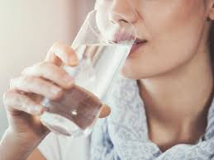

WATER TECHNOLOGY
The process of removing all types of impurities from water and making it fit for domestic or industrial purposes is called water technology or water treatment.

Slide 14
Basic need for water..
According to national and international guidelines,
The quantity of water available to all people should be 50–100 litres per person per day, or an absolute minimum of 20 litres per person per day (UNDP, 2006).
The water must be safe for drinking and other household uses. Drinking water must be free from pathogenic (disease-causing) micro-organisms (tiny living organisms thatyou can see only with a microscope), and free from chemical and physical contaminants that constitute a danger to a person’s health.
It must also be free from colour and odour. Water must be within safe physical reach, in or near the house, school or health facility.
water should also be reasonably priced and affordable for everyone. Buying water should not reduce a person’s capacity to buy other essential goods

Slide 15
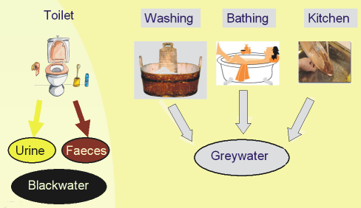

Slide 16
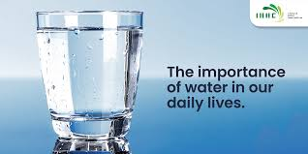
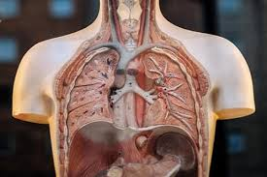

Slide 17
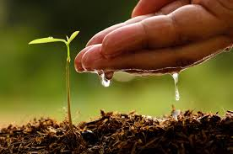
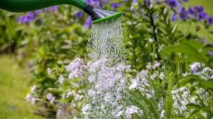


Slide 18
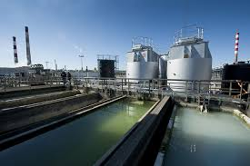
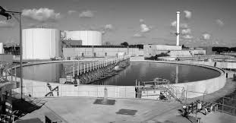

Slide 19
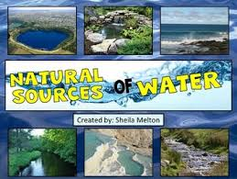

Slide 20
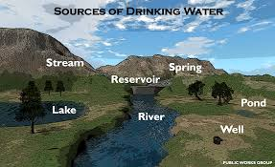

Slide 21
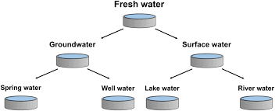

Slide 22
Sources of Water
A) Surface Waters
Rain Water - Pure but contaminated with gases River Water - High dissolved salts moderate
organics
Lake Water - Const. composition but high organics Sea Water - High salinity, pathogens, organics
B) Underground Waters
Spring/Well Water - Crystal clear but high dissolved
salts and high purity from organics
2

Slide 23
MAJOR IMPURITIES OF WATER
Ionic and dissolved
Cationic Calcium Magnesium
Anionic Bicarbonate Carbonate Hydroxide
Nonionic and undissolved Turbidity, silt, mud, dirt and other suspended matter
Gases CO₂
H₂S NH₃ CH₄ O₂
Alkalinity
Sodium Potassium Ammonium Iron Manganese
Color, Plankton Organic matter,
Sulfate
Chloride Colloidal silica,
Nitrate
Phosphate
Microorganisms,
Bacteria
3

Slide 24
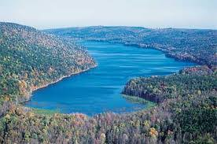
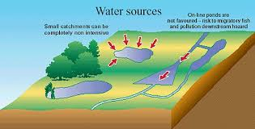
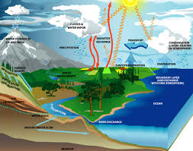
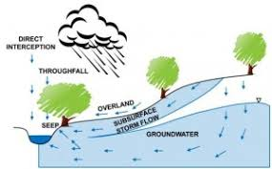

Slide 25
TYPES OF WATER
HARD WATER:
Water , which does not produce lather with soap solution, but produces white precipitate (Scum) is called hard water.
Ex.
2C17H35COONa + CaCO3-------- (C17H35COO)2Ca+ Na2CO3
SOFT WATER:
Water , which produce lather with soap solution,is called soft water.
HARDNESS
Hardness is a property which prevents lathering with soap. Hardness is due to the presence of chlorides, sulphates and bicarbonates of calcium and magnesium.
Hardness is of two types - Carbonate (temporary) and Non-carbonate (Permanent) hardness

Slide 26
Molecular weights of some hardness producing salts.
Hardness producing salt | Molecular weight | Hardness producing salt | Molecular weight
Ca(HCO₃)₂ | 162 | MgSO₄ | 120
Mg(HCO₃)₂ | 146 | MgCO₃ | 84
Mg(NO₃)₂ | 148 | MgCl₂ | 95
Ca(NO₃)₂ | 164 | CaCl₂ | 111
CaCO₃ | 100 | Ca2+ | 40
CaSO₄ | 136 | Mg2+ | 24

Slide 27

Expression of hardness in terms of equivalents of CaCO₃
The amount of hardness producing salts is usually expressed in terms of an equivalent amount of CaCO₃. CaCO₃ is chosen as a standard because,
Its molecular weight (100) and equivalent weight (50) is a whole number, so the Calculations in water analysis can be simplified.
2. It is the most insoluble salt, that can be precipitated in water treatment. If the
concentration of hardness producing salt is x mgs/lit.then\

Slide 28
Units of Hardness
1. Parts per million(ppm)
It is defined as the number of parts of CaCO₃ equivalent hardness per 106 parts of water.
2. Milligrams per litre(mg/lit)
It is defined as the number of milligrams of CaCO₃ equivalent hardness per 1 litre of water.
3. Clarke’s degree (oCl)
It is defined as the number of parts of CaCO₃ equivalent hardness per 70,000 parts of water.
4. French degree(oFr)
It is defined as the number of parts of CaCO₃ equivalent hardness per 105 parts of water.
Relationship between various units
1ppm = 1 mg/lit = 0.10 Fr = 0.070Cl

Slide 29
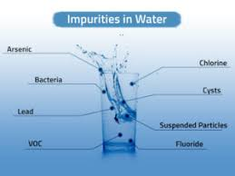
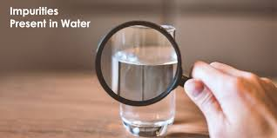
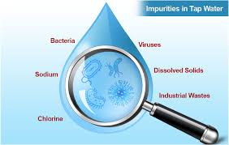

Slide 30
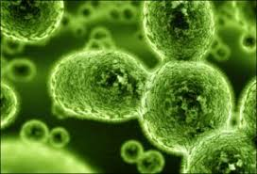
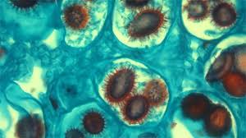
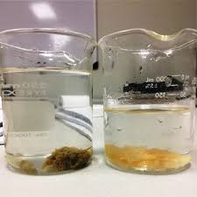
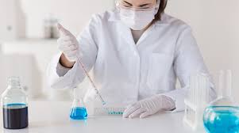

Slide 31
Impurities of water..
Impurities or pollutants in natural water is defined as the contamination of the Physical ,Chemical or Biological properties of any water.
It may be classified into 3 types as…
Physical impurities
Chemical impurities
Biological impurities
Physical impurities…
Suspended matters :(Ex) :Sand , clay , oil globules,vegetable and animal mater impart turbidity to water.
Colloidal impurities: (Ex) : Emulsified oils, dyes, finely divided silica, fats, ethers etc imparts colour , odour and taste to water.
Chemical impurities…
Dissolved salts like bicarbonates, carbonate, chloride ,sulphate, nitrate, Phosphates of Na , K ,Ca ,Mg , Fe

Slide 32
WATER QUALITY…

Slide 33
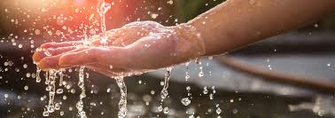
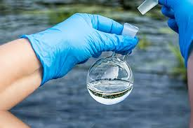
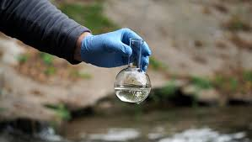

Slide 34
Water Quality Parameters
Can be divided into three types:
Physical - pH, turbidity, colour , odour, temperature
Chemical – Total Dissolved solids, alkalinity, hardness
Biological – COD, BOD

Slide 35
Water quality parameters..
Three parameters is used for quality of water.
Physical parameters
Chemical parameters
Biological parameters
Physical parameters…
Physical parameters of water (temperature, colour, taste, odour and etc.) are determined by senses of touch, sight, smell and taste.
For example temperature by touch, colour, floating debris, turbidity and suspended solids by sight, and taste and odour by smell.
Temperature…
The temperature of water affects some of the important physical properties and characteristics of water: thermal capacity, density, specific weight, viscosity, surface tension, specific conductivity, salinity and solubility of dissolved gases and etc.
Chemical and biological reaction rates increase with increasing temperature. Reaction rates usually assumed to double for an increase in temperature of 10 °C. The temperature of water in streams and rivers throughout the world varies from 0 to 35 °C.

Slide 36
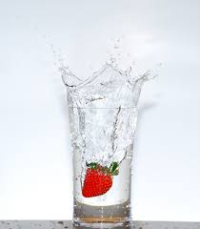
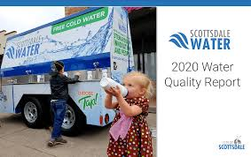
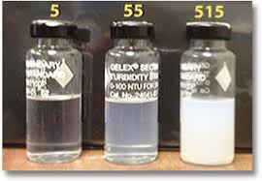
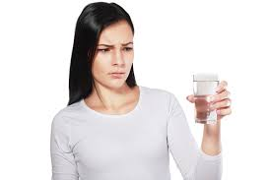

Slide 37
Colour..
Colour in water is primarily a concern of water quality for aesthetic reason. Coloured water give the appearance of being unfit to drink, even though the water may be perfectly safe for public use.
On the other hand, colour can indicate the presence of organic substances, such as algae or humic compounds. More recently, colour has been used as a quantitative assessment of the presence of potentially hazardous or toxic organic materials in water.
Taste and odour..
Taste and odour are human perceptions of water quality.
Human perception of taste includes sour (hydrochloric acid), salty (sodium chloride), sweet (sucrose) and bitter (caffeine).
Relatively simple compounds produce sour and salty tastes.
However sweet and bitter tastes are produced by more complex organic compounds. Human detect many more tips of odour than tastes.
Organic materials discharged directly to water, such as falling leaves, runoff, etc., are sources of tastes and odour-producing compounds released during biodegradation.

Slide 38
pH
pH value expresses the intensity of the acidic or basic characteristic of water.
pH is the negative logarithm of the hydrogen ion concentration.
pH scale ranges from 0 to 14, with a pH of 7.0 corresponding to the neutral point.
Values of pH below 7.0 are acidic
above 7.0, values are basic or alkaline
The pH of most groundwater's and surface waters - between 5 and 9.
Seawater - pH between 8.0 and 8.5.

Slide 39
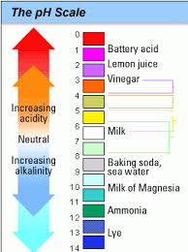
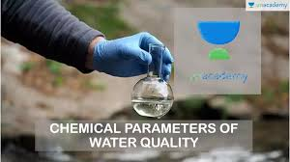
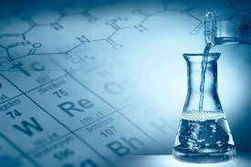
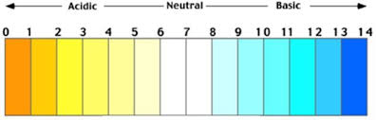

Slide 40
The optimum pH for the growth and health of most freshwater aquatic animals is in the range of 6.5 to 9.0.
Exposure to extreme pH can be lethal
pH controls a wide variety of solubility and equilibria reactions, the most important of which is the relationship between the un-ionized and the ionized form of ammonia and nitrite.
pH also affects the toxicity of hydrogen sulfide and metals such as copper, cadmium, zinc and aluminum.

Slide 41
2. Turbidity
Source(s):
- Inorganic compounds such as clay, sand
- Organic compounds such as plant fibre, human waste
Effect(s):
- Aesthetic
- Adsorption point/centre for chemicals and micro-organisms
- Health aspect

Slide 42
3. Odour and Taste
Source(s):
- Inorganic compounds such as minerals, metals, salts (all of them give taste to water but no odour)
- Organic compounds from petroleum and/or degradation of organic matters. (odour and taste)
Effect(s):
- Aesthetic
- Health problems [reaction from sources and other chemicals such as chlorine (Cl₂)]

Slide 43
4. Temperature
Source(s):
- Effect from ambience
- Industrial activities - cooling system
Effect(s):
- Disturb biological activities such as micro-organism and aquatic life
- Chemical properties such as the degree of gas solubility, density and viscosity

Slide 44
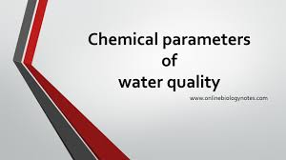

Slide 45
Chemical Parameters
1. Total dissolved solid (TDS)
- Solid left in water after the water is filtered and dried.
Source(s):
- Inorganic compounds - minerals, metals & gases
- Organic compounds – product from degradation of organic matters, organic gas
Effect(s):
- Cause taste, colour and odour problems
- Health aspect

Slide 46
TDS Measurement
1. The water sample is filtered and the filtrate is collected in a flask. The minimum sample volume should be 100 ml (C).
2. The filtrate is transferred to a ceramic or glass Pyrex container. The weight of the empty container should be noted (A). The container with the filtrate is placed in the drying oven and heated to 103 °C for 24 hours. Then, it is heated upto 180 °C for 8 hours.
3. After the container is cooled, the weight of the container with the residue is noted (B).
TDS (mg/L) = ((B - A)/ C)* (1000 mg/g) * (1000 ml/L)

Slide 47
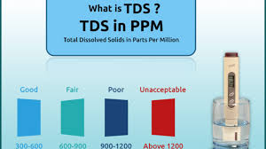
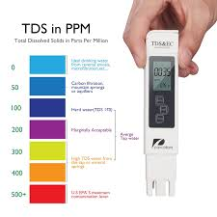
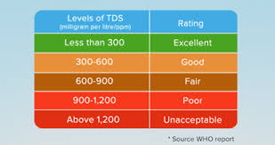
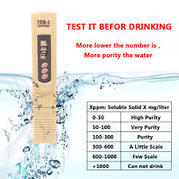

Slide 48
Water can be classified by the level of total dissolved solids (TDS) in the water:
Fresh water: TDS is less than 1,000 mg/L
Brackish water: TDS = 1,000 to 10,000 mg/L
Saline water: TDS = 10,000 to 35,000 mg/L
Hypersaline:TDS greater than 35,000 mg/L
Drinking water generally has a TDS below 500 mg/L.

Slide 49
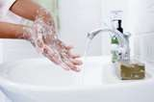
2. HARDNESS OF WATER
Hardness in Water is a characteristic that prevents the ‘lathering of soap’ . The water which does not produce lather with soap solution readily, but forms a white curd is called hard water. But the soft water lathers readily with soap.
Hardness refers to the presence of calcium and magnesium ions in water (and sometimes iron).
49

Slide 50
Type of Hardness
Temporary or Carbonate Hardness
Permanent Hardness or non-carbonate Hardness.
1

Slide 51
Temporary Hardness
– Temporary Hardness is caused by the presence of dissolved bicarbonate of
calcium, magnesium and other heavy metals and the carbonate of iron.
It is mostly destroyed by more boiling of water, when bicarbonates are decomposed yielding insoluble carbonates.
Ca(HCO₃)₂ Heat CaCO₃ + H₂O + CO₂
Calcium bicarbonate Calcium Carbonate
Mg(HCO₃)₂ Heat Mg(OH)₂ + 2CO₂
Magnesium Bicarbonate Magnesium hydroxide
– Calcium/Magnesium Carbonates thus formed being almost insoluble, are
deposited as a scale at the bottom of vessel, while carbon dioxide escapes out.
51

Slide 52
PERMANENT HARDNESS
Non Carbonate Hardness is due to the presence of chlorides, sulfates of
calcium, Magnesium, iron and other heavy metals
2C₁₇H₃₅COONa + CaCl₂
(C₁₇H₃₅COO)₂Ca + 2NaCl
Calcium stearate (Insoluble)
Sodium stearate (sodium soap)
Hardness
2C₁₇H₃₅COONa + MgSO₄
(C₁₇H₃₅COO)₂Mg + 2Na₂SO₄
Magnesium stearate (Insoluble)
Sodium stearate (sodium soap)
Hardness
52

Slide 53
BOD…
BOD is expressed in mg/L or ppm.
Determination of BOD..
BOD measurements require taking two samples at each side.One is tested immediately for dissolved oxygen and the second is incubated in dark at 20c for 5 days and the tested for the amount of remaining DO.
a). DO content of the sample tested immediately is known as initial DO, D1.
b). DO content of the sample tested after5 days is known as final DO, D2
The differences in oxygen levels between the initial DO and final DO in mg/L is the amount of BOD.
BOD5 = (D2-D1) x dilution factor
Dilution factor = Volume of the sample/ volume of sample + Diluted water
Why is BOD important?
Water samples having a BOD value greater than 10mg/L are considered to be highly polluted.
The higher the BOD, higher will be stress, suffocation to the microorganisms.
+

Slide 54
ALKALINITY
DEFINITION:
Alkalinity is the acid neutralising ability of water. Depending on the anions that are responsible for the alkalinity of water, there are three types of alkalinity.
TYPES OF ALKALINITY:
Alkalinity – due to hydroxide ions
Carbonate alkalinity - due to carbonate ions
Bicarbonate alkalinity - due to bicarbonate ions
The alkalinity due to hydroxide and carbonate can be detected by Phenolphthalein indicator and so they are collectively called as Phenolphthalein Alkalinity, represented by P. The alkalinity due to hydroxide, carbonate and bicarbonate can be detected by Methyl orange indicator and so it is called as in Methyl orange Alkalinity, represented by M.

Slide 55
Draw backs (or) Disadvantages of Hard Water
Domestic Use
Industrial Use
Washing
Bathing
Drinking
Cooking
Textile Industry
Sugar Industry
Dyeing Industry
Paper Industry
Pharmaceutical Industry
In Steam generation in Boilers
The sticky precipitate adheres on the fabric/cloth and gives spots and streaks. Fe salts stain the cloths.
Produces sticky scum on the bath tub and
the body
Bad to the digestive system and calcium oxalate formation is possible in urinary tracts
Requires more fuel and time. Certains food don’t cook soft and also gives unpleasant taste
10

Slide 56
Boiler troubles due to Hard Water
1. Scale and Sludge
1. Sludge
Slimy loose precipitate called sludge suspended in water
2. Caustic embitterment
3. Priming and Foaming
4. Boiler corrosion
water
4
Boiler wall
Sludge is a soft, loose and slimy precipitate formed within the boiler. It can be easily scrapped off with a wire brush.
It is formed at comparatively colder portions of the boiler and collects in areas of the
system, where the flow rate is slow or at bends.
It is formed by substances which have greater solubility's in hot water than in cold water, e.g. MgCO₃, MgCl₂, CaCl₂, MgSO₄ etc.,
Remedy: Sludges can be removed using wire brush or mild acid
11

Slide 57
DISADVANTAGE OF SLUDGE FORMATION:
-poor conductor of heat
-disturbs the working of boiler.
- If along with scales : both get deposited as scales.
Preventation of Sludge formation:
Well softened water
Drawing off a portion of concentrated water.
12

Slide 58
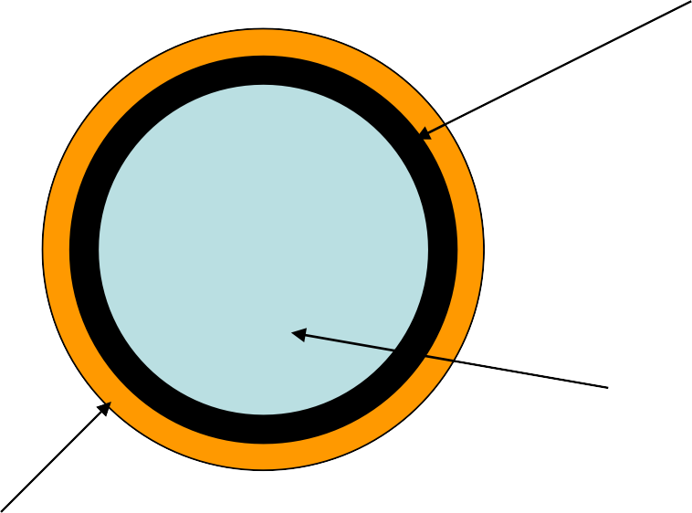
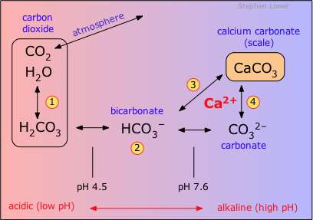
1. Scale
Hard adherent coating on inner walls of boiler
water
Boiler 6
wall
5
Scales are hard substances which sticks very firmly to the inner surfaces of the boiler wall.
Scales are difficult to remove even with the help of a hammer and chisel.
Examples: CaSO₄, CaCO₃, Mg(OH)₂
13

Slide 59
Reasons for formation of scale
1. Presence of Ca(HCO₃)₂ in low pressure boilers
Ca(HCO₃)₂ CaCO₃ + H₂O + CO₂
Calcium bicarbonate Calcium Carbonate (scale)
Low pressure boilers but in high pressure
boilers it is soluble by forming Ca(OH)₂
2. Presence of CaSO₄ in high pressure boilers
TºC Solubility of CaSO₄
15 3200 ppm
230 15 ppm
320 27 ppm
Cold water soluble
Super heated water Insoluble (scale)
4. Presence of SiO₂
It forms insoluble hard adherent CaSiO₃ and MgSiO₃ as scales
3. Presence of MgCl₂ in high temperature boilers
MgCl₂ + 2 H₂O
Magnesium chloride
Mg (OH)₂ + 2HCl
scale
Mg(OH)₂ can also be generated by thermally decomposing Mg(HCO₃)₂
59

Slide 60
Disadvantages of scale formation
Fuel wastage – scales have low thermal conductivity
Degradation of boiler material and increases of risk of accident
Reduces the efficiency of the boiler and- deposit on the valves and condensers
The boiler may explode – if crack occurs in scale
Remedies: Removal of scale
Using scrapper, wire brush often
By thermal shock- heating and cooling suddenly with cold water
Using chemicals – 5-10% HCl and by adding EDTA
60

Slide 61
Prevention of scale formation
Scale formation can be prevented by two methods
Internal conditioning or Internal Treatment
External conditioning or External treatment- will be discussed later
1. Internal conditioning methods - of boiler water to prevent scale formation
Phosphate conditioning – addition of phosphate compound
Carbonate conditioning – addition of carbonate compound
Calgon conditioning – addition of sodium hexa meta phosphate
Colloidal conditioning – spreading of organic compounds like tannin, agar gel
Sodium Aluminate – removes oil and silica
Electrical Conditioning
Radioactive Conditioning
Complexometric method – using EDTA
16

Slide 62
1. Phosphate conditioning
Scale formation can be prevented by adding sodium phosphate to the boiler water which reacts with the hardness producing ions and forms easily removable phosphate salts of respective ions
3CaCl₂ (Boiler water) + 2 Na₃PO₄ Ca₃(PO₄)₂ + 6 NaCl
17

Slide 63
Selection of Phosphate compound
Calcium can not be precipitated below a pH = 9.5, hence the selection of
phosphate has to be based on the pH of the boiler feed water.
NaH₂PO₄ (acidic in nature) ,
Na₂HPO₄ (weakly alkaline in nature),
Na₃PO₄ (Alkaline in nature)
2. Carbonate conditioning
CaSO₄ (Boiler water) + Na₂CO₃ CaCO₃ + Na₂SO₄
Caution: Excess Na₂CO₃ can result in caustic embrittlement
63

Slide 64
3. Calgon conditioning
Na2[Na4(PO3)6 2Na+
+ [Na4P6O18]2-
Calgon – sodium hexa meta phosphate
2CaSO4 (Boiler water) + [Na4P6O18]2-
Calcium sulfate
[Ca2P6O18]2- + 2Na2SO4
Soluble complex ion of calcium - can be removed easily
Calgon tablets are used in the cleaning of washing machine drums
64

Slide 65
4.Colloidal conditioning:
In low pressure boilers- scale : adding org. substances like kerosine, agar-agar, tannin,etc.
- Yield non-sticky & loose deposits
5. Treatment withNaAlO₂:
NaAlO₂ + 2H2O
MgCl₂ + 2NaOH
NaOH + Al(OH)₃(gelatinous ppt)
Mg(OH)₂ + 2NaCl
20

Slide 66
6.Electrical conditioning:
Sealed glass bulbs-mercury: battery
Water boils- mercury bulb - emit electrical discharged
7. Radioactive conditioning: Tablets - radioactive salts
8. Complexometric method:
1.5% alk. Soln of EDTA
EDTA : cation & form stable & soluble complex.
21

Slide 67
Other treatment:
Prevent : iron oxide
Protects boiler unit from corrosion by wet steam.
Reduces the carry over of oxides with steam
22

Slide 68
CAUSTIC EMBRITTLEMENT:
Is a type of boiler corrosion.
Caused : highly alkaline Water.
Na₂CO₃ + H₂O → 2 NaOH + CO₂
Boiler water – becomes ‘caustic’
Water evaporates – caustic soda concentration increase. which attacks surrounding area of boiler machine.
Iron converted in to sodium ferroate.
Causes embrittlement of boiler parts, strssed parts( bends, joints, etc.) Iron : in dilute NaOH – cathodic side
Iron : in concentrated NaOH – anodic side.
23

Slide 69
Preventation of caustic Embrittlements:
Sodium phosphate – sodium carbonates
Adding lignin : preventing infilteration of caustic soda solution
Sodium sulphate: Na₂SO₄ concentration
NaOH concentration
Kept 1:1, 2:1 & 3:1,
Pressure : 10,20 & above 20.
24

Slide 70
IV. Boiler corrosion
Degradation or destruction of boiler materials (Fe) due to the chemical or electrochemical attack of dissolved gases or salts is called boiler corrosion
Boiler corrosion is of three types
Corrosion due to dissolved O₂
Corrosion due to dissolved CO₂
Corrosion due to acids formed by dissolved salts
1. Corrosion due to dissolved oxygen (DO)
2 Fe + 2 H₂O + O₂
2 Fe(OH)₂
2 [Fe₂O₃.2H₂O]
Rust
4 Fe(OH)₂ + O
Ferrous hydroxide
2

Slide 71
Removal of Dissolved Oxygen (DO)
1. By the addition of chemicals
The dissolved oxygen present in the boiler feed water can be removed by the addition of sodium sulphite or hydrazine and the reactions can be written as
below 2 Na₂SO₃
+ O₂ 2 Na₂SO₄
Sodium sulphite
DO
Sodium sulphate
Na₂S
+ 2O₂
N₂ + 2H₂O
Na₂SO₄
N₂H₄ + O₂
Hydrazine
Nitrogen

Slide 72
2. Corrosion due to dissolved CO₂
Presence of bicarbonate salts of either magnesium or calcium also causes the release of CO₂ inside the boiler apart from the dissolved CO₂
Mg(HCO₃)₂ MgCO₃ + H₂O + CO₂
CO₂ + H₂O H₂CO₃ (causes slow corrosion)
3. Corrosion due to dissolved salts
MgCl₂ + 2 H₂O Mg(OH)₂ + 2HCl
Fe + 2 HCl FeCl₂ + H₂
FeCl₂ + 2 H₂O Fe(OH)₂ + 2HCl

Slide 73
Prevention :
(1) Corrosion can be prevented by adding alkali to neutralize acidity & anti-oxidant to remove oxygen
(2) By keeping pH value 8 to 9.
(3) Oxygen is removed from boiler feed-water by adding Na2SO3.
(4) Oxygen can also removed by treating it with hydrazine hydrate NH2–NH2
NH2-NH2 + O2 → 2N2 + 2H2O
28

Slide 74
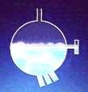

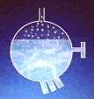

III. Priming and foaming
Foaming
It is the production of continuous foam or hard bubblers in boilers. Foaming is due to the presence of substance like oil in boiling water.
Priming
It is the process in which some particles in water are carried along with the steam. The resulting process is called as wet steam or carry over. The process of formation of wet steam in boilers is called as priming.
Foaming
Normal bubble
Priming
Carry over bubble
7

Slide 75
Causes of Priming
(1) the presence of large amount of dissolved solids
(2) high steam velocities.
(3) sudden boiling
(4) improper boiler design
(5) sudden increase in steam-production rate.
Disadvantages of Priming
(1) Dissolved salt in boiler water are carried out by the wet steam to turbine
blades - which reduces their efficiency.
(2) Dissolved salts may enter the parts of other machinery may decrease the life of the machinery.
(3) Actual height of the water column cannot be judge properly, Thereby
making the maintenance of the boiler pressure becomes difficult.
30

Slide 76
Prevention of Priming
(1) By improving boiler design.
(2) By fitting mechanical steam purifiers.
(3) By maintaining low water level in boilers
(4) By using soft water.
(5) By decreasing the amount of dissolved salts.
( B) FOAMING :
It is the production of foam or bubbles in boiler which do not break easily.
Causes of Foaming :
It is due to the presence of oily substances in water.
(1) Low level of water in boiler.
(2) The presence of dissolved salts in water.
(3) Sudden increase in steam production rate.
31

Slide 77
Disadvantages of foaming :
(1) Actual height of the water column cannot be judge.
(2) Dissolved salts in water carried by the wet steam may damage turbine blads or machinery parts.
(3) Boiler pressure cannot be maintained.
Prevention of Foaming :
(1) By the addition of anti-foaming chemicals like castor oil, Gallic
acid, tennic acid etc.
(2) removing oil from boiler water by adding compounds like sodium aluminate.
32

Slide 78
II . Softening of water/ External treatment of water – External
Conditioning of water
Softening of hard water can be done by the following methods
Lime soda process
Zeolite methods
Ion exchange resin method
Mixed bed deionizer method
1. Lime soda process
It is a process in which Lime (Ca(OH)₂) and soda (Na₂CO₃) are added to the hard water to convert the soluble calcium and magnesium salts to insoluble compounds by a chemical reaction. The CaCO₃ and Mg(OH)₂ so precipitated are filtered off and removed easily.
It is further divided in to two types
Cold lime soda process
Hot lime soda process

Slide 79
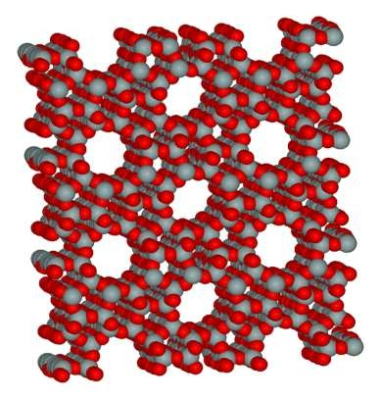
2. ZEOLITE OR PERMUTIT PROCESS:
Zeolite - hydrated sodium alumino silicate, capable of exchanging reversibly its sodium ions for hardness- producing ions in water.
The general chemical structure of Zeolite:
Na₂O.Al₂O₃.xSiO₂.yH₂O
(x = 2-10 and y = 2-6)
Micro pores of Zeolite
10
Porous structure of Zeolite
43

Slide 80
Two types:
Natural Zeolite: non-porous. e.g., Natrolite
Synthetic zeolite: porous & possess gel structure.
They are prepared by heating together china clay, feldspar and soda ash.
Zeolites possess higher exchange capacity per unit weight than natural zeolite.

Slide 81
Process:
Hard water is percolated at a specified rate through a bed of zeolite,
kept in a cylinder.
The hardness-causing ions are retained by the zeolite as CaZe and MgZe; while the outgoing water contains sodium salts.
To remove temporary hardness
Na₂Ze + Ca(HCO₃)₂ Na₂Ze + Mg(HCO₃)₂
CaZe + 2NaHCO₃ MgZe + 2NaHCO₃
To remove permanent hardness
Na₂Ze + CaCl₂ Na₂Ze + MgCl₂
CaZe + 2NaCl MgZe + 2NaCl

Slide 82
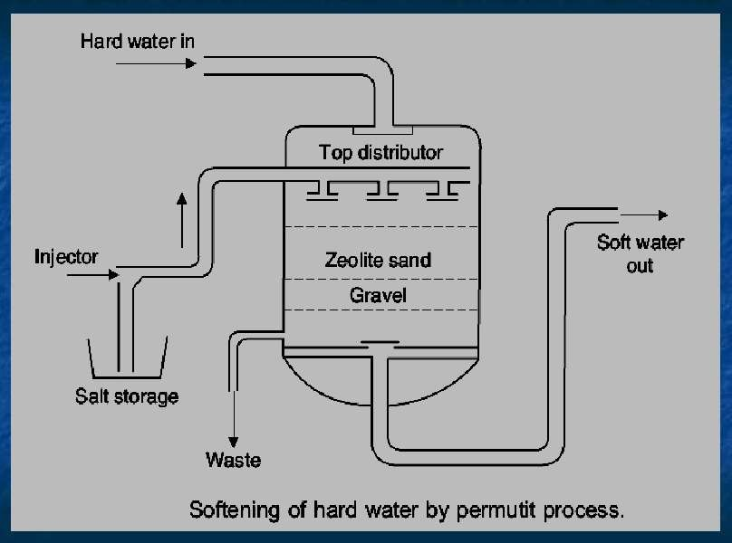

Slide 83
REGENERATION OF ZEOLITE:
At this stage, the supply of hard water is stopped and exhausted zeolite is reclaimed by treating the bed with concentrated NaCl solution.
CaZe or MgZe + 2NaCl
(exhausted zeolite) (Brine)
Na₂Ze + CaCl₂
(Reclaimed zeolite) (washings)

Slide 84
LIMITATIONS OF ZEOLITE PROCESS:
If the water is turbid ---- then the turbidity causing particles
clogs the pores of the Zeolite and making it inactive
The ions such as Mn²⁺ and Fe²⁺ forms stable complex Zeolite which can not be regenerated that easily as both metal ions bind strongly and irreversibly to the zeolite structure.
Any acid present in water (acidic water) should be neutralized with soda before admitting the water to the plant, since acid will hydrolyze SiO₂ forming silicic acid

Slide 85
ADVANTAGES:
Residual hardness of water is about 10 ppm only
Equipment is small and easy to handle
Time required for softening of water is small
No sludge formation and the process is clean
Zeolite can be regenerated easily using brine solution
Any type of hardness can be removed without any modifications to the process.
DISADVANTAGES :
1. Soft water contains more sodium salts than in lime soda process
2. It replaces only Ca²⁺ and Mg²⁺ with Na⁺ but leaves all the other ions like HCO ⁻ and
3
CO ²⁻ in the softened water (then it may form NaHCO and Na CO which releases CO
3 3 2 3
when the water is boiled and causes corrosion)
2
3. It also causes caustic embitterment when sodium carbonate hydrolyses to give NaOH

Slide 86
ION EXCHANGE PROCESS:
Ion exchange resins are insoluble, cross linked, long chain organic polymers with a microporous structure, and the functional groups attached to the chain is responsible for the “ion-exchange” properties.
Acidic functional groups (-COOH, -SO3H, etc.) exchange H+ with other cations.
Basic functional groups (-NH2=NH etc.) exchange OH- with other anions.

Slide 87
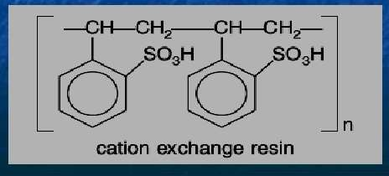
Classification of Resins
A. Cation-exchange Resins(RH+) : Strongly acidic (SO₃⁻H⁺) and weakly acidic (COO⁻H⁺) cation exchange resins
12

Slide 88

2. Anion Exchange resin (ROH⁻) – Strongly basic (R₄N⁺OH⁻)
and weakly basic (RNH₂⁺OH⁻) anion exchange resins
52
13

Slide 89

53
14

Slide 90
Process or Ion-exchange mechanism involved in water softening
Reactions occurring at Cation exchange resin
2 RH⁺ + Ca²⁺ (hard water) R₂Ca²⁺ + 2 H⁺
2 RH⁺ + Mg²⁺ (hard water) R₂Mg²⁺ + 2 H⁺
Reactions occurring at Anion exchange resin
2 ROH⁻ + SO₄²⁻ (hard water) R₂SO₄²⁺ + 2 OH⁻
2 ROH⁻ + Cl⁻ (hard water) R₂Cl⁻ + 2 OH⁻
At the end of the process
_{H}+
+ OH⁻ H₂O

Slide 91
Regeneration of ion exchange resins
Regeneration of Cation exchange resin
R₂Ca²⁺ + 2H⁺ (dil. HCl (or) H₂SO₄) 2 RH⁺ + Ca²⁺ (CaCl₂, washings)
Regeneration of Anion exchange resin
R₂SO₄²⁻ + 2OH⁻ (dil. NaOH) 2 ROH⁻ + SO₄²⁻ (Na₂SO₄, washings)
Advantages
The process can be used to soften highly acidic or alkaline waters
It produces water of very low hardness of 1-2ppm. So the treated waters by this method can be used in high pressure boilers
Disadvantages
The setup is costly and it uses costly chemicals
The water should not be turbid and the turbidity level should not be more
than 10ppm
5
5

Slide 92
DESALINATION OF BRACKISH WATER
Process of removing common salt from water.
Brackish water: water containing dissolved salts with a peculiar salty taste
Sea water : 3.5% salts. 1.Electrodialysis, 2.Reverse osmosis.

Slide 93
ELECTRO DIALYSIS
Principle:
Electrodialysis is an electrochemical process whereby electrically charged particles, ions, are transported from a raw solution (retentate, diluate) into a more concentrated solution (permeate, concentrate) through ion-selective membranes by applying an electric field.

Slide 94

17
60

Slide 95
THEORY OF ELECTRODIALYSIS
Electro dialysis chamber comprises of sheet like barriers made out of high-capacity, highly cross-linked ion exchange resins that allow passage of ions but not of water.
There are two types : (a) Cation exchange and (b) Anion exchange membranes
Cation exchange membranes consists of an insoluble matrix and mobile cation reside in the pore space that allows the pass through of only cations.
Anion exchange membranes consists of an insoluble matrix and mobile anion
reside in the pore space that allows the pass through of only anions.
Cation- and Anion- exchange membranes are installed alternatively in the tank.
By impressing electricity on the electrodes, the positive anode attracts negative ions in solution, while the negative cathode attracts positive ions in the solution.
61

Slide 96
Na+ : negative pole,
Cl- : positive pole.
Concentration of brine decreases : central compartment.
It increases: two side compartment.
Desalinated brine : removed
Concentrated brine : replaced by fresh water.
Electrodialysis cell : consists of a large no. of rigid plastic membrane.
Saline water is passed & electric field is applied.
Positive charges : repel positive ions & permit negative ion.
Negative charges.
Water: deprived of its salts,
Salt concentration : increases in adjacent compartment.
62

Slide 97
Advantage:
Most compact unit,
Economical,
If electricity is easily available, it is best suited

Slide 98
REVERSE OSMOSIS:
When two solutions of unequal concentration are separated by a semi-permeable membrane, flow of solvent takes place from dilute to concentration side, due to increase in osmostic pressure, which is termed as osmosis.
However, when a hydrostatic pressure in excess of osmotic pressure is applied on the concentrated side, the solvent flow is reversed from concentrated side to dilute side, across the membrane. This principle is termed as reverse osmosis.

Slide 99


Reverse Osmosis
65
18

Slide 100
The semi-permeable membrane (in reverse osmosis) is selective in not permitting the passage of dissolved solute particles such as molecules, ions, etc.) It permits only the flow of water molecules (solvent) from the concentrated to dilute side.
Cellulose acetate, polyamide, etc., are used as membrane
Reverse osmosis process requires only mechanical force to
generate the required hydrostatic pressure.
66

Slide 101
POTABLE WATER
Water : safe to drink,
Fit for human consumption, should satisfy the following requirements:
Clear & odourless,
Pleasant in taste,
Perfectly cool,
Turbidity should not exceed 10ppm,
Free from objectionable dissolved gases
Objectionable minerals: lead,arsenic, Mn, Cr
7. pH:8.0
Reasonably soft,
Free from disease-producing microorganisms.
67

Slide 102
BREAK-POINT CHLORINATION
Involves in addition of sufficient amt. of chlorine to oxidise :organic matter, reducing substances.
Dosage of applied chlorine to water rich in organic compound or ammonia is gradually increased.
Four stages:
The addition of chlorine at the dip or break : ’ breakpoint’ chlorination.
This indicates the point at which free residual chlorine begins to appear.
All tastes, odour disappear at break point : water free from bad tastes and odours.

Slide 103
Persistent & powerful disinfection possessed by available free chlorine, any type of pathogenic organisms present : destroyed.
Advantages:
Oxidises completely organic compound, ammonia &
other reducing compound.
Removes colour
Removes disease producing bacteria
Removes odour & taste.

Slide 104
DE-CHLORINATION
Over-chlorination after the break point : produces unpleasant taste &
odour
Removed by filtering the over-chlorinated water through a bed of molecular carbon.
Activated C : added directly & after a short reaction period :
removed by filteration.
SO₂ / sodium sulphite / sodium thiosulphate.
SO₂ + Cl₂ + 2H₂O H₂SO₄ + 2HCl
Na₂SO₃ + Cl₂ + H₂O Na₂SO₄ + 2HCl

Slide 105
REFERENCE:
Image 1: http://postimg.org/image/9dskyjsvj/
Image 2: http://postimg.org/image/3kawku281/
Image 3: http://postimg.org/image/ritblpo01/
Image 4: http://www.slideshare.net Image 5:http://www.slideshare.net
Image 6: http://postimg.org/image/rhjdsam69/
Image 7: http://postimg.org/image/d0w4dpwox/
Image 8: http://postimg.org/image/ficgyq5z5/
Image 9: http://postimg.org/image/c7o3yug1t/
Image 10: http://postimg.org/image/a82wtowch/

Slide 106
Image 11: http://postimg.org/image/sc5xebu0x/
Image 12: http://postimg.org/image/51wcwe6yp/
Image 13: http://postimg.org/image/dnzmgziyp/
Image 14: http://www.slideshare.net
Image 15:http://www.slideshare.net Image 16:http://www.slideshare.net
Image 17:http://postimg.org/image/p1m5s6thd/ Image 18:http://postimg.org/image/mqetl9cbr/

